Slide 1
HNDIT1012 Visual Application Programming
Week 8

Slide 2
Graphics object.
You can draw many different shapes and lines by using following methods of a Graphics object.
DrawLine
DrawArc
DrawClosedCurve
DrawPolygon
DrawRectangle
DrawEllipse.

Slide 3
Pen Class
Pen Defines an object used to draw lines and curves.
(Same as a drawing pen or pencil)
You need a paper and pen/pencil to draw a drawing. Similarly in C# you can imagine graphic object as a paper and you are going to draw some thing using a pen.
Pen has several properties including:
Color and
Width

Slide 4
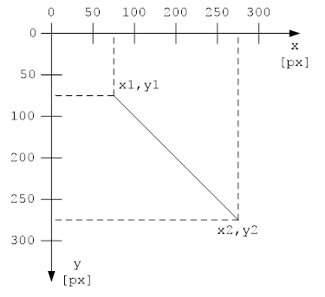
Coordinate System
To draw a line, start point and end point must be defined. Start point is set by the values of x1 and y1. End point is set by the values of x2 and y2.
In this case
x1 = y2 = 75 pixels and
x2 = y2 = 275 pixels.

Slide 5
DrawLine(Pen, Int32, Int32, Int32, Int32)
Draws a line connecting the two points specified by the coordinate pairs.
Parameters
pen
Pen
Pen that determines the color, width, and style of the line.
x1
Int32
The x-coordinate of the first point.
y1
Int32
The y-coordinate of the first point.
x2
Int32
The x-coordinate of the second point.
y2
Int32
The y-coordinate of the second point.

Slide 6
Example
The following code example is designed for use with Windows Forms, and it requires PaintEventArgs e, which is a parameter of the Paint event handler. The code performs the following actions:
Creates a black pen.
Creates the coordinates of the endpoints of the line.
Draws the line to the screen.

Slide 7
public void DrawLineInt(PaintEventArgs e)
{
// Create a black pen with thickness 3 .
Pen blackPen = new Pen(Color.Black, 3);
// Create coordinates of points that define line.
int x1 = 100;
int y1 = 100;
int x2 = 500;
int y2 = 100;
// Draw line to screen.
e.Graphics.DrawLine(blackPen, x1, y1, x2, y2);
}

Slide 8
DrawEllipse(Pen, Int32, Int32, Int32, Int32)
Parameters
pen
Pen
Pen that determines the color, width, and style of the ellipse.
x
Int32
The x-coordinate of the upper-left corner of the bounding rectangle that defines the ellipse.
y
Int32
The y-coordinate of the upper-left corner of the bounding rectangle that defines the ellipse.
width
Int32
Width of the bounding rectangle that defines the ellipse.
height
Int32
Height of the bounding rectangle that defines the ellipse.

Slide 9
Example
The following code example is designed for use with Windows Forms, and it requires PaintEventArgs e, which is a parameter of the Paint event handler. The code performs the following actions:
Creates a black pen.
Creates the position and size of a rectangle to bound an ellipse.
Draws the ellipse to the screen.
private void DrawEllipseInt(PaintEventArgs e)
{
// Create pen.
Pen blackPen = new Pen(Color.Black, 3);
// Create location and size of ellipse.
int x = 0;
int y = 0;
int width = 200;
int height = 100;
// Draw ellipse to screen.
e.Graphics.DrawEllipse(blackPen, x, y, width, height);
}

Slide 10
Thank You

